Slide 1


Slide 2
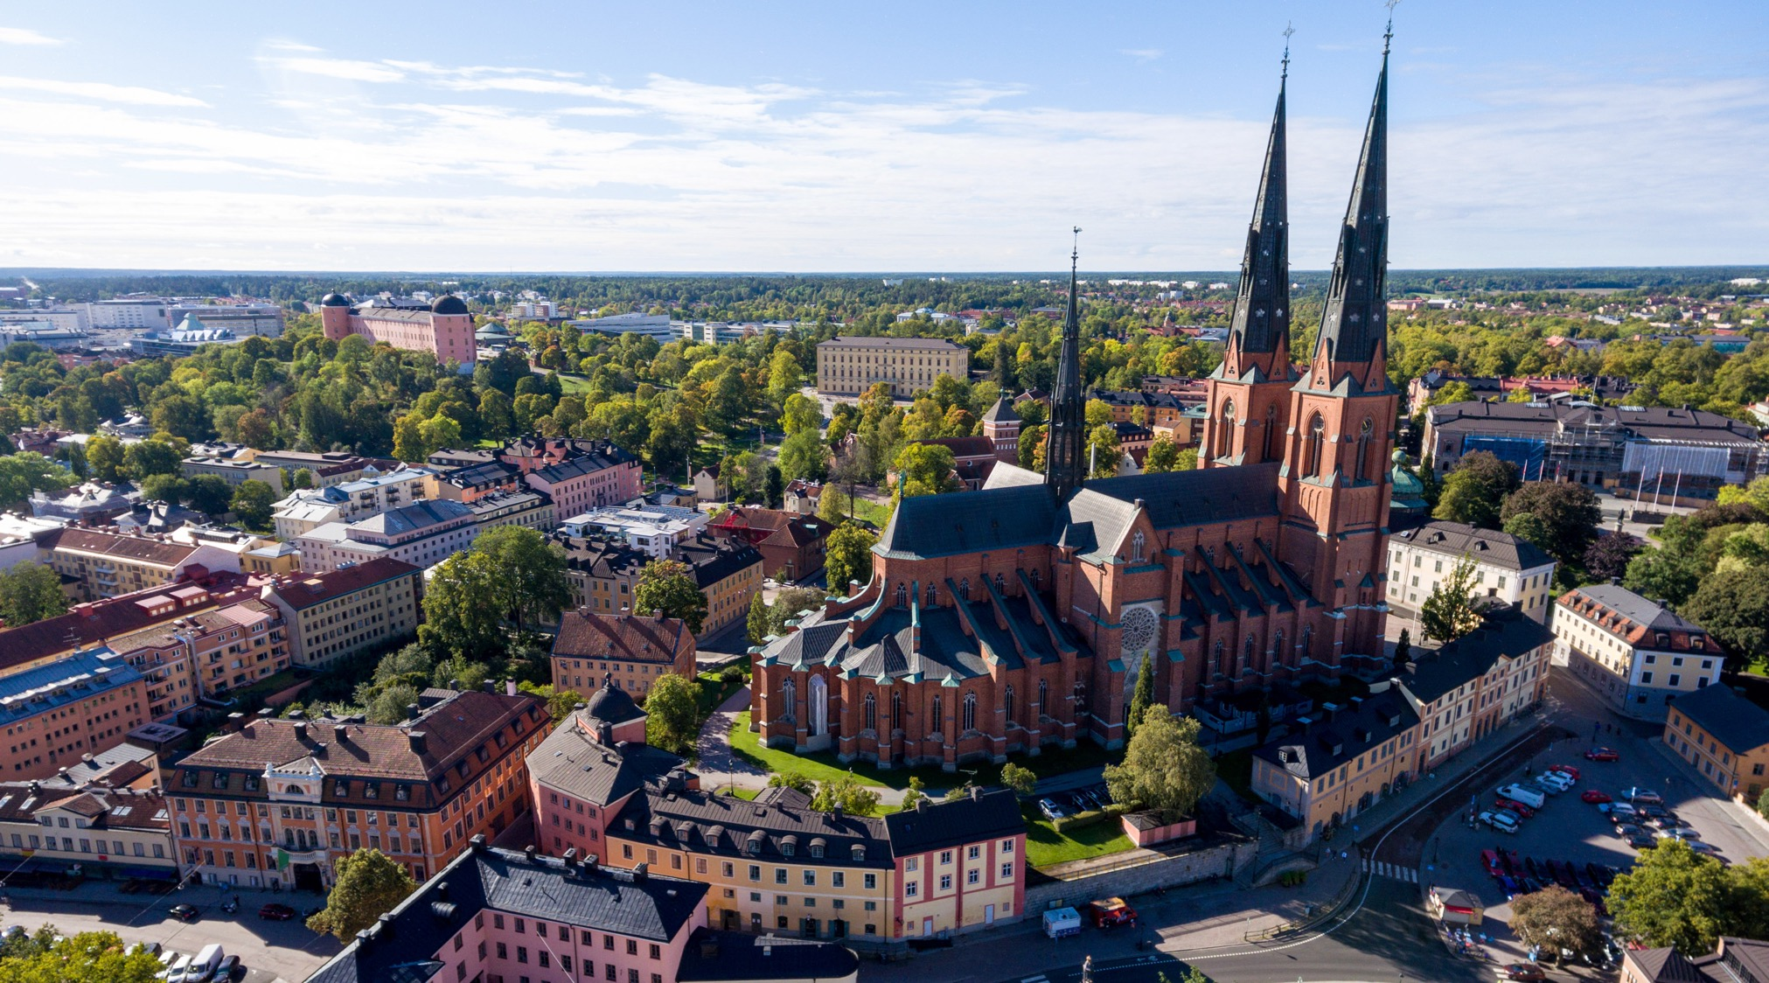
WELCOME TO UPPSALA

Slide 3
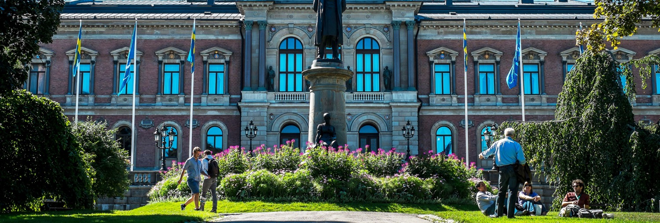
WELCOME TO UPPSALA UNIVERSITY
ALWAYS MOVING FORWARD – SINCE 1477
A MEETING PLACE FOR KNOWLEDGE, CULTURE AND CRITICAL DIALOGUE

Slide 4

OUR MISSION
TO GAIN AND SHARE KNOWLEDGE
FOR THE BENEFIT OF HUMANKIND AND FOR A BETTER WORLD

Slide 5
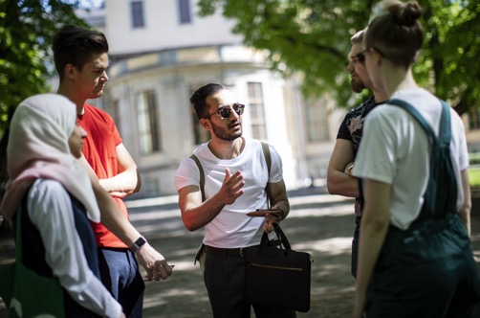
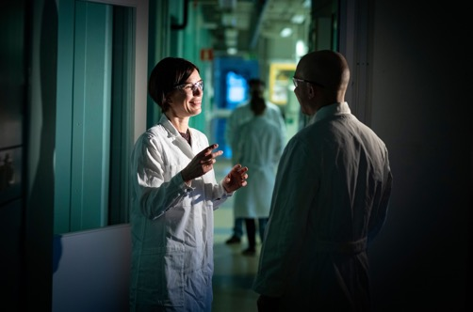
OUR GOAL: RESEARCH AND EDUCATION OF THE HIGHEST QUALITY AND RELEVANCE
Uppsala University rests on the idea and conviction that investing in education and research leads to a better future.
The University will put all its breadth and strength into supporting sustainable development and promoting openness and respect.
The University operates at the heart of the society to which it belongs. Collaboration enables the academic knowledge base to make an impact and be of use in society.
Uppsala University upholds the free pursuit of knowledge in education and research and stands up for academic integrity, diversity and quality.

Slide 6
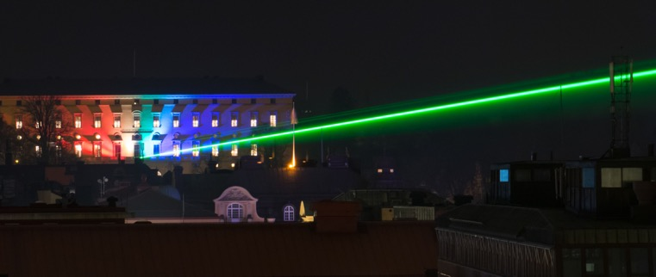
DEVELOPMENT GOALS TO CONSTANTLY
RENEW EDUCATION AND RESEARCH
Expand education and strengthen the connection between education and research.
Develop research excellence.
Strengthen transdisciplinary and challenge-driven research.
Coordinate and concentrate the University’s resources.
Exploit the potential of Campus Gotland.
Develop collaboration as an integral part of education and research.

Slide 7

STRATEGIC PRIORITIES TO ENHANCE
QUALITY AND RELEVANCE
Quality assurance and enhancement
Internationalisation
Infrastructure
Talent attraction and career systems
Support and wider environment
Notes:
Quality assurance and enhancement: active and systematic approach to quality assurance and enhancement within education, research and collaboration.
Internationalisation: a means of and strategy for achieving higher quality research and education. Internationalisation should be guided by principles of quality, endurance and reciprocity in international relations and the development of deepened, strategic collaboration with selected universities and world regions. Uppsala University aspires to take an active role in the global community, and to promote development, creativity and innovation so as to contribute to global development.
Infrastructure: successful research depends on infrastructure of an internationally high standard in the form of experimental equipment, databases, libraries, collections and biobanks.
Talent attraction and career systems. Appointment Regulations
Support and wider environment: Development Plan 2050

Slide 8
IN BRIEF ...
Over 50,000 students and 7,700 employees
60 departments – in 9 faculties – in 3 disciplinary domains
Creative interdisciplinary settings in distinct campus areas
400,000 square metres of facilities
Turnover SEK 8 billion – 70% in research
Ranked among the world’s top universities

Slide 9
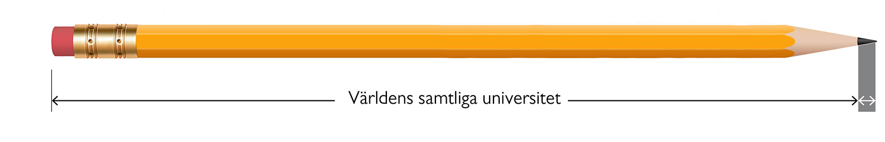
RANKING
Uppsala University claims a place among the best in the three largest world rankings:
ARWU (Shanghai Ranking)
THE (Times Higher Education)
QS Ranking
Uppsala University among the leaders
All world universities
New ranking: QS World University Ranking: Sustainability.
Measures universities’ efforts to move forward on sustainable development and has two components: environmental impact and social impact.
Uppsala University takes 11th place out of 700 higher education institutions worldwide – the top institution in the EU.

Slide 10



EDUCATION AND RESEARCH IN
THREE DISCIPLINARY DOMAINS
Humanities and Social Sciences
6 faculties
Medicine and Pharmacy
2 faculties
Science and Technology
1 faculty

Slide 11
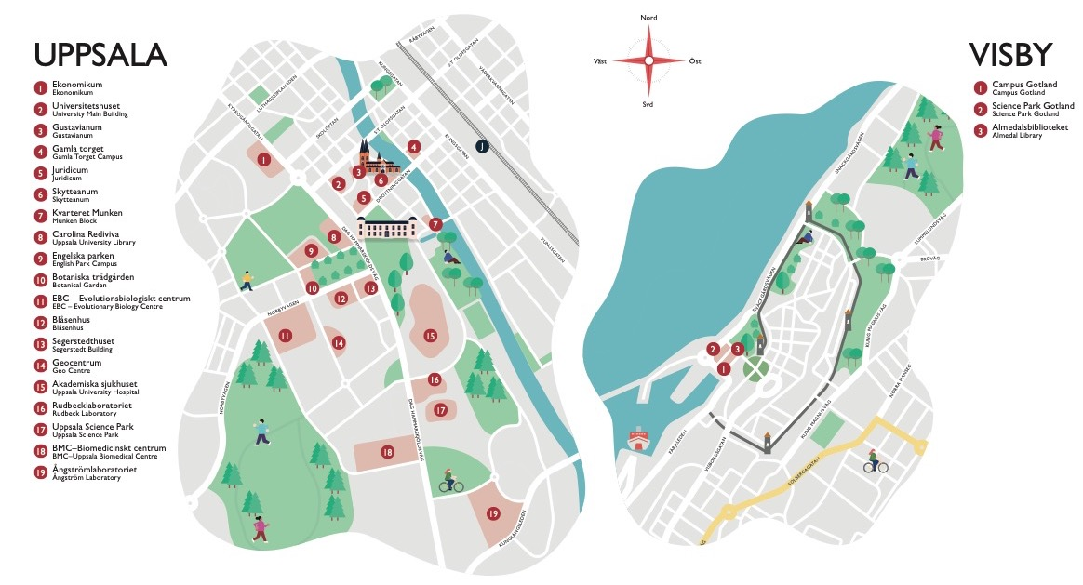
THE UNIVERSITY AREA

Slide 12
UPPSALA

Slide 13
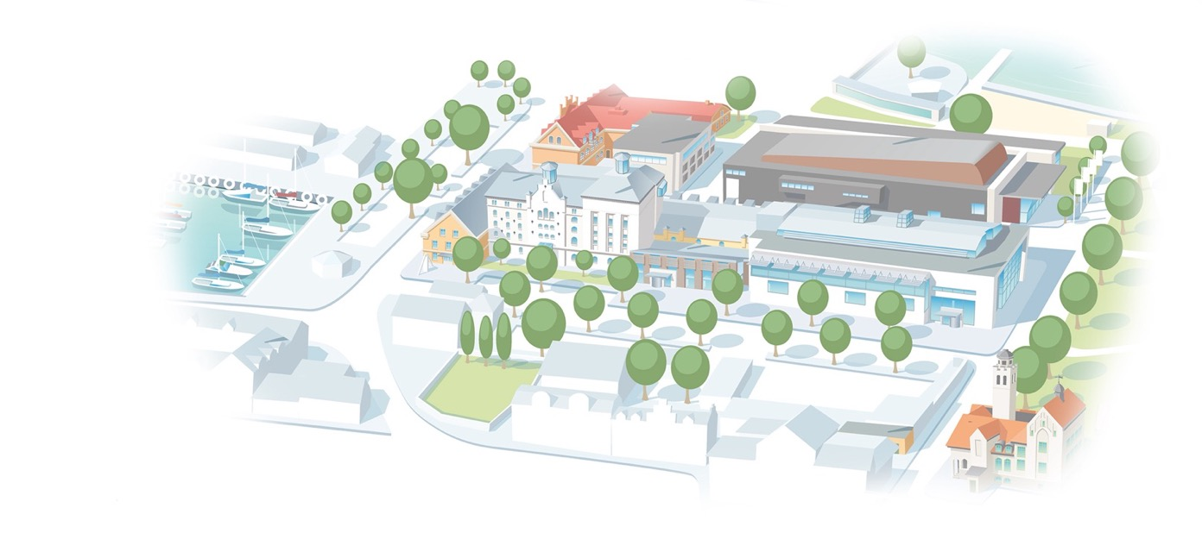
CAMPUS GOTLAND

Slide 14
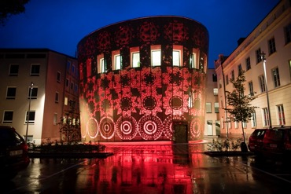
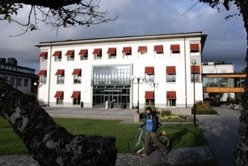
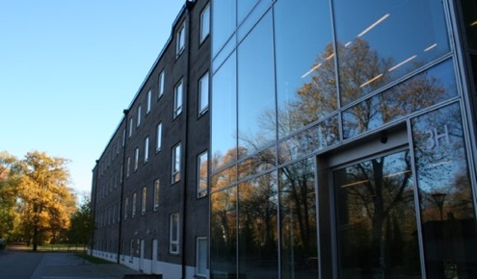
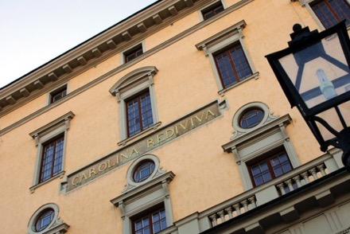
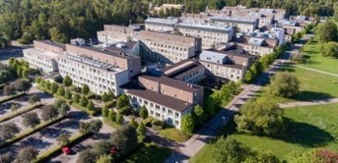
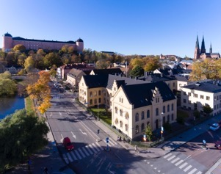
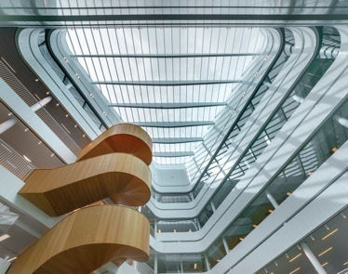
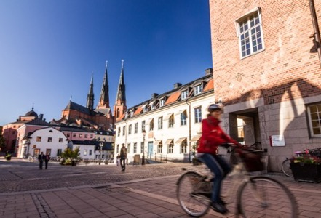
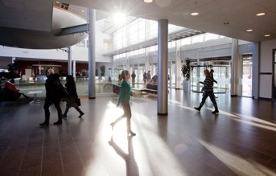
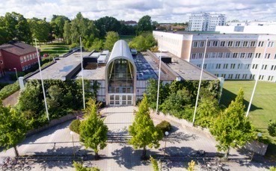
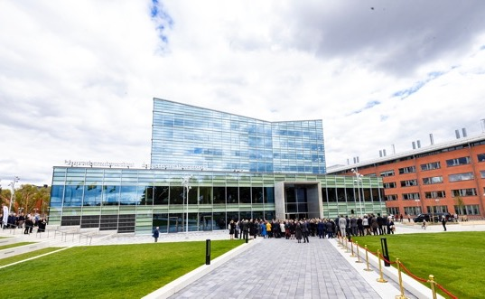

Slide 15
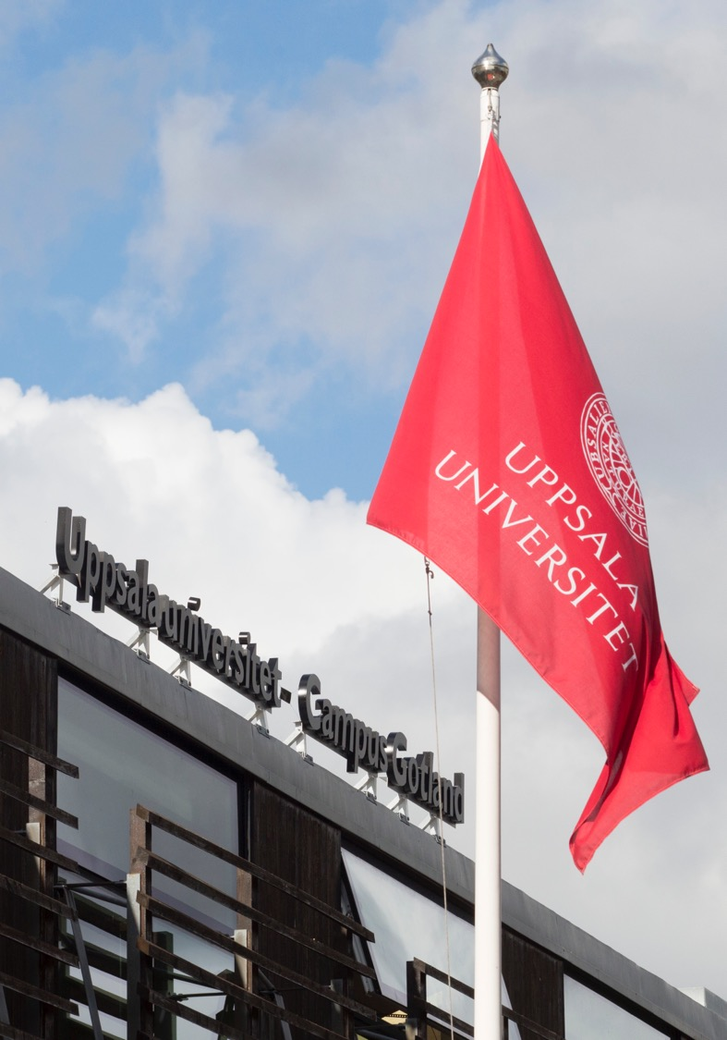
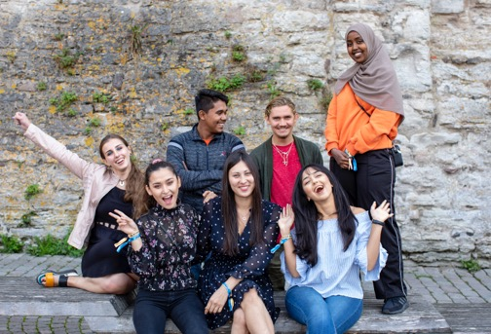
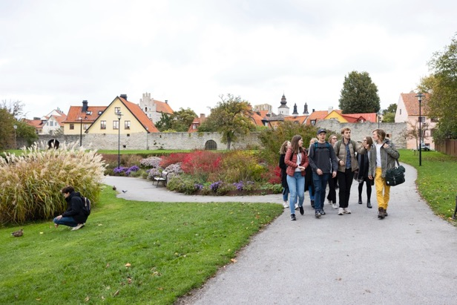
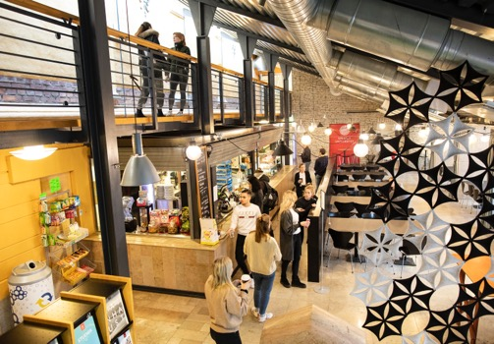
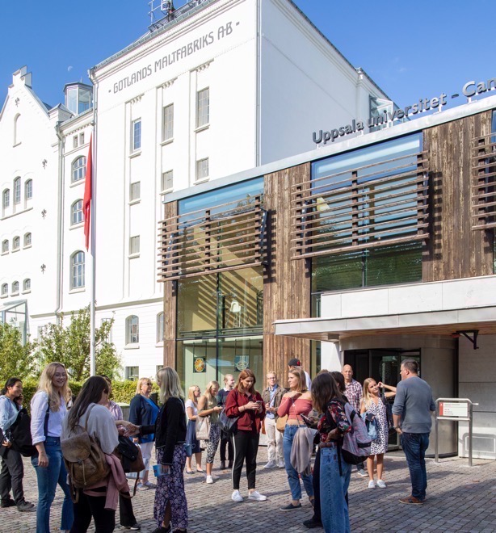


Slide 16
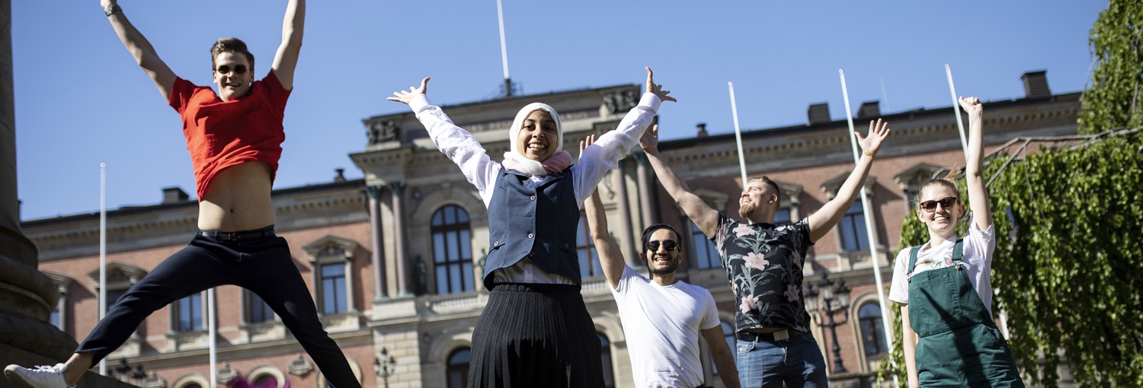
EDUCATION
BROAD RANGE OF PROGRAMMES • RESEARCH-BASED • STUDENT LIFE

Slide 17

EDUCATION IN NUMBERS
Some 50,000 students
Around 75 undergraduate programmes
Around 90 Master’s programmes
Roughly 2,000 freestanding courses
Most popular programmes: law, medicine and psychology
Around 6,500 degrees per year
Some 70 international Master’s programmes
Around 650 freestanding courses in English
International student exchanges: approximately 1,400 incoming and 1,000 outgoing students
Some 1,700 fee-paying students from third countries

Slide 18
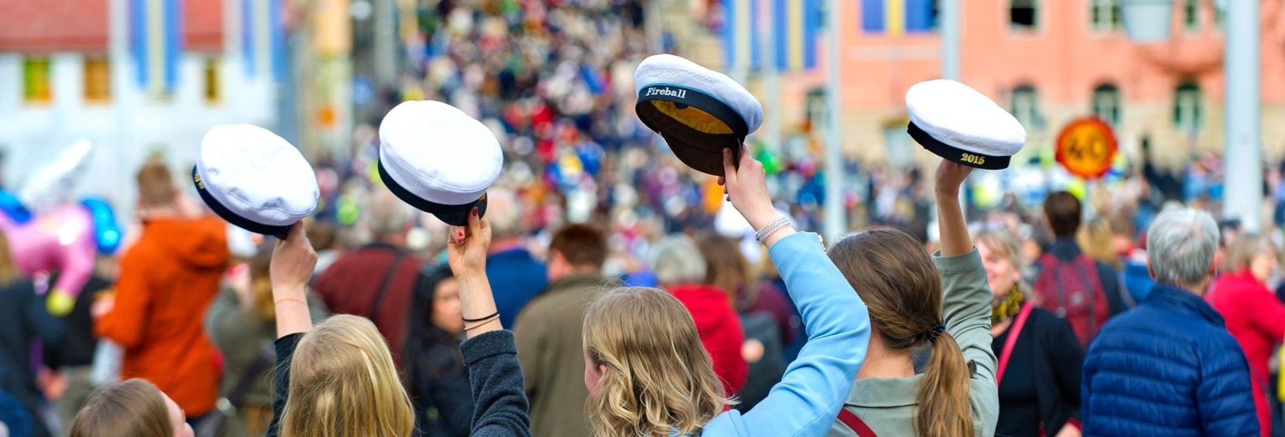
STUDENT LIFE
13 STUDENT ‘NATIONS’ • 6 STUDENTS’ UNIONS •
ACTIVE STUDENT PARTICIPATION • TRADITIONS

Slide 19

RESEARCH
STRONG INDIVIDUAL DISCIPLINES • INTERDISCIPLINARITY •
INTERNATIONAL NETWORKS • EXTERNAL COLLABORATION
Notes:
Because of the breadth of subjects it offers, Uppsala University is well placed to help meet challenges facing society at national level and contribute towards achieving the UN’s global sustainability goals.
Achieving these goals requires a combination of technological development, community planning and changes in human behaviour, along with decisions that build on scientifically based knowledge.
In recent years, Uppsala University has conducted many interdisciplinary and cross-cutting initiatives.

Slide 20
WE ARE TACKLING THE RESEARCH CHALLENGES OF THE FUTURE
ANTIBIOTIC RESISTANCE
ARTIFICIAL INTELLIGENCE
BIODIVERSITY
CLIMATE CHANGE
DEMOCRACY
DIGITAL HUMANITIES
DRUG DEVELOPMENT
ENERGY
GLOBAL HEALTH
HUMAN RIGHTS
LIFE SCIENCES
MAJOR COMMON DISEASES
MEDICAL TECHNOLOGY
MENTAL HEALTH
MIGRATION AND RACISM
NEW MATERIALS
ORIGINS AND EVOLUTION OF LIFE
SOCIAL SUSTAINABILTY

Slide 21

RESEARCH AND PHD PROGRAMMES
IN NUMBERS
Around 170 PhD subject areas
Some 2,500 PhD students (50% women)
More than 300 PhD degrees per year
Some 5,200 peer-reviewed scholarly publications per year
Revenue for research and PhD programmes:
Approx. SEK 5,600 million (70% of total turnover)
Over 50% of research funding comes from external sources

Slide 22
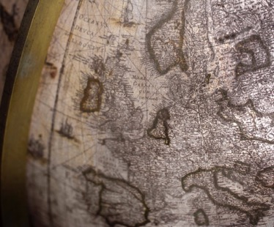
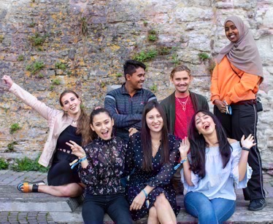
INTERNATIONAL NETWORKS AND COOPERATION
EXAMPLES:
The Guild
Coimbra
Southern African–Nordic Centre (SANORD)
Matariki
ENLIGHT European University
U4Society
Baltic University Programme
ACCESS, MIRAI 2.0, SIREUS, SASUF
Uppsala University Alumni Network:
Over 30,000 alumni in 150 countries
Notes:
https://www.uu.se/en/about-uu/international/
Uppsala university aspires to strengthen its position as a leading international research university. International collaboration is a means of and strategy for achieving higher quality research and education. Internationalisation should be guided by principles of quality, endurance and reciprocity in international relations and the development of deepened, strategic collaboration with selected universities and world regions. Uppsala University aspires to take an active role in the global community, and to promote development, creativity and innovation so as to contribute to global development.

Slide 23
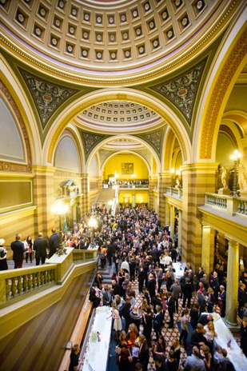

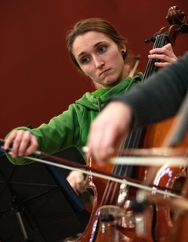
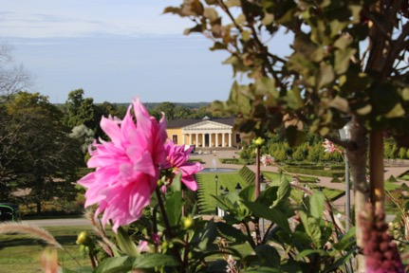
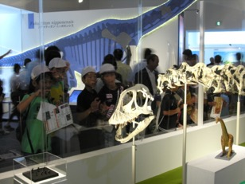
CULTURE AND CULTURAL HERITAGE
Museums, art, historical cultural sites, academic traditions, music, gardens... Uppsala University has unique cultural heritage collections and rich cultural offerings.
Museums: Museum of Evolution, Gustavianum, Museum of Medical History, Uppsala University Library
Music: Royal Academic Orchestra, Uppsala University Jazz Orchestra, Uppsala Choir Centre, student nation choirs
The Linnaean Gardens
The Uppsala University Linnaean Garden and the Botanical Garden are the oldest botanical gardens in Sweden and house more than 9,000 plant species.
Notes:
https://www.uu.se/en/about-uu/culture/

Slide 24


Slide 25
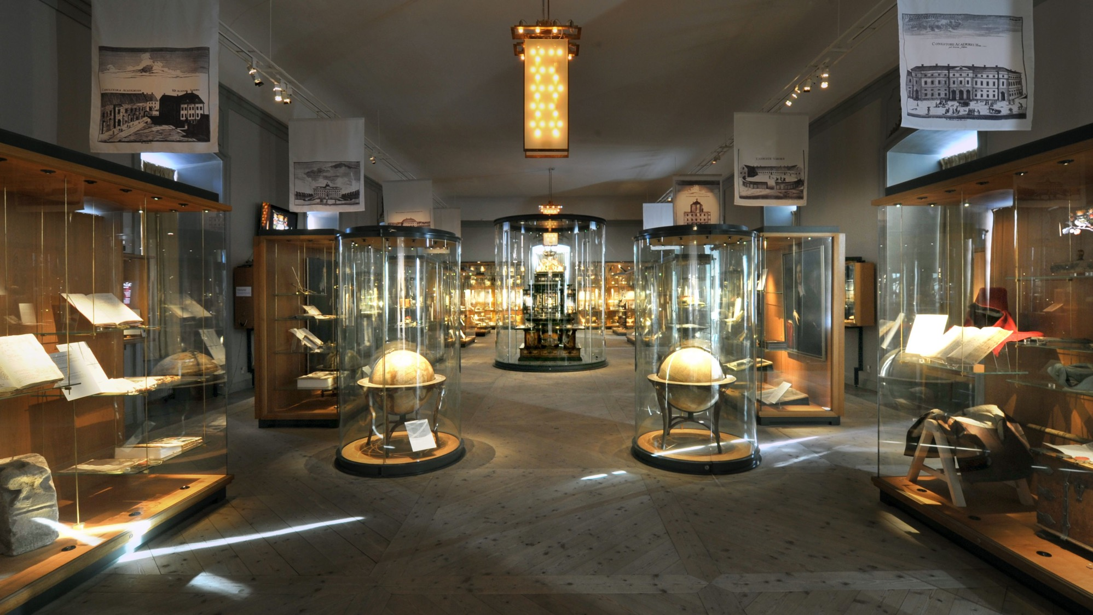

Slide 26
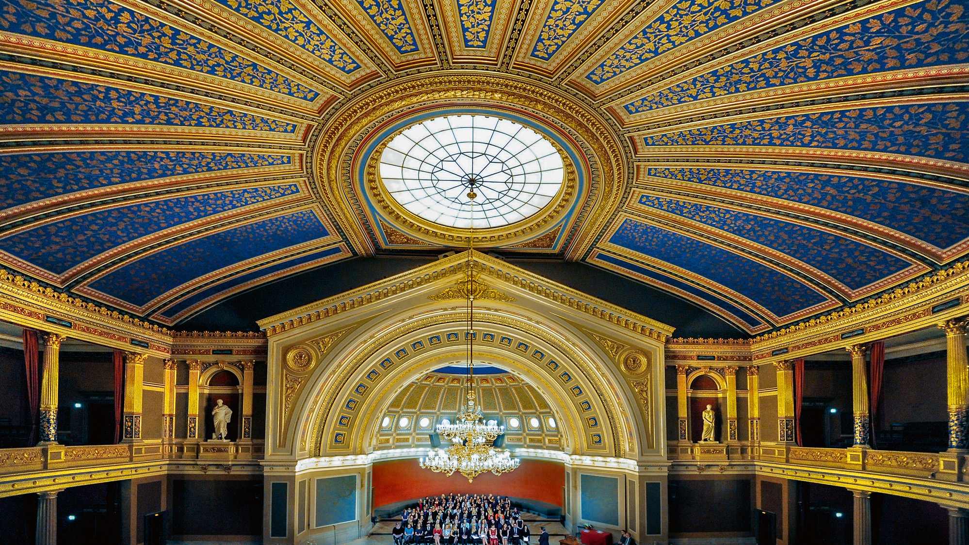

Slide 27
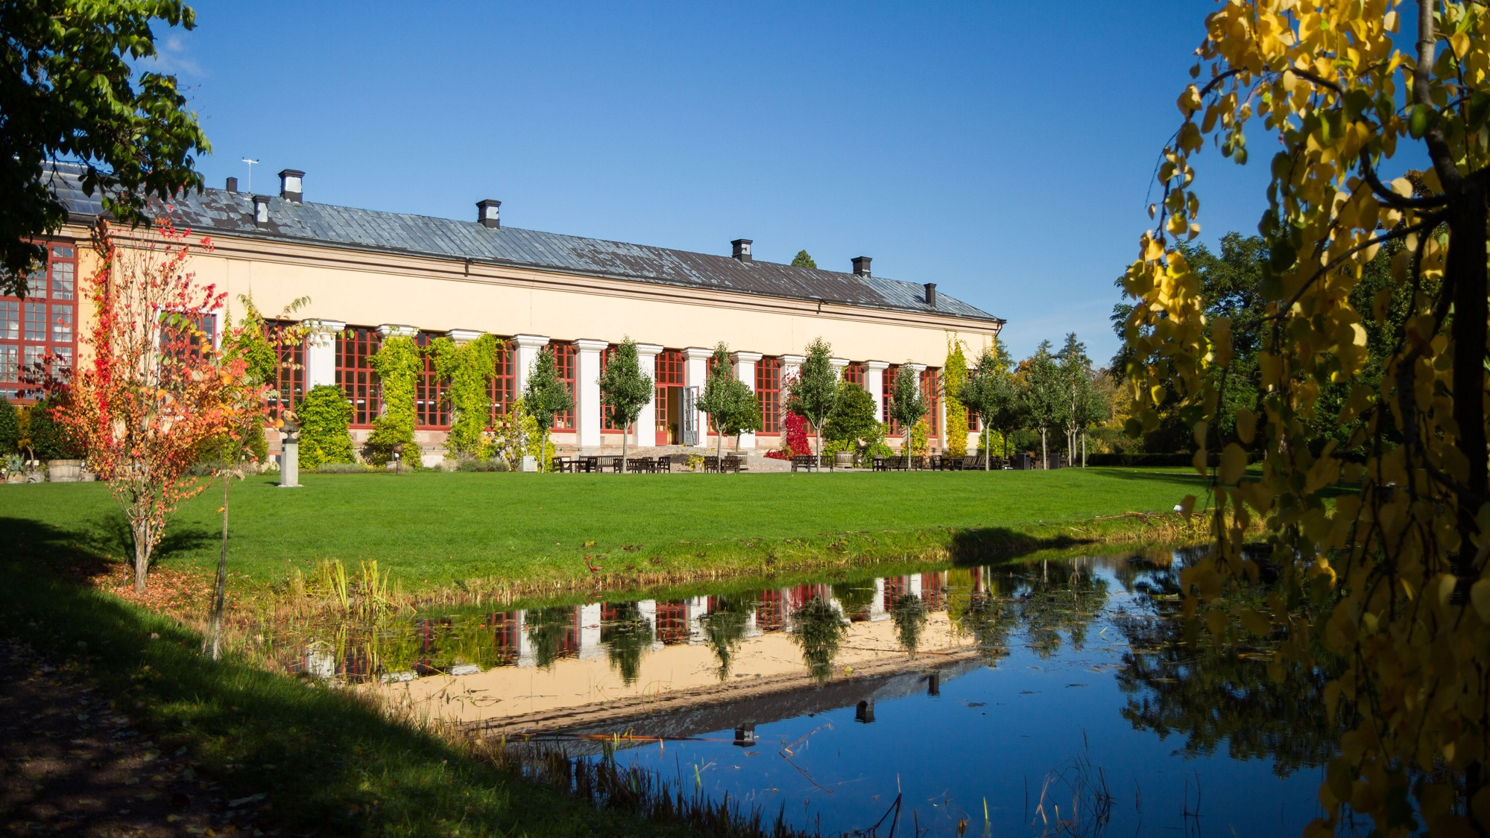

Slide 28
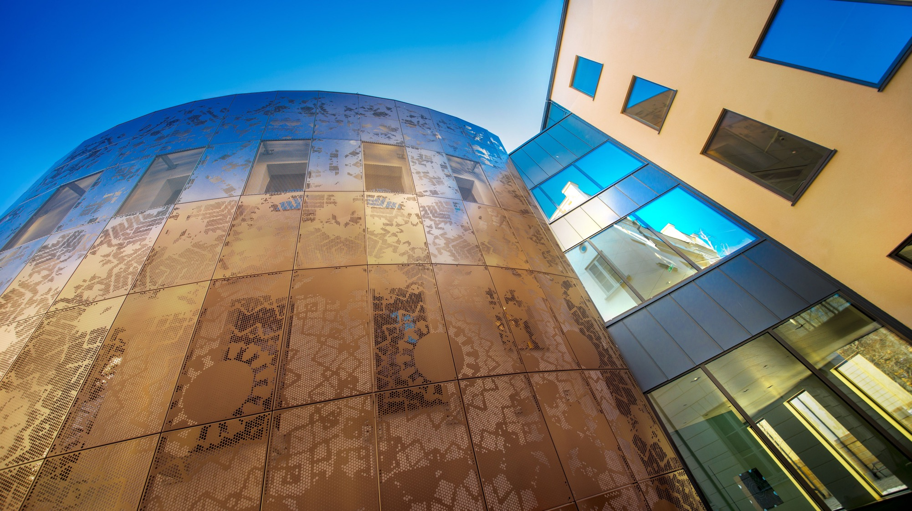

Slide 29
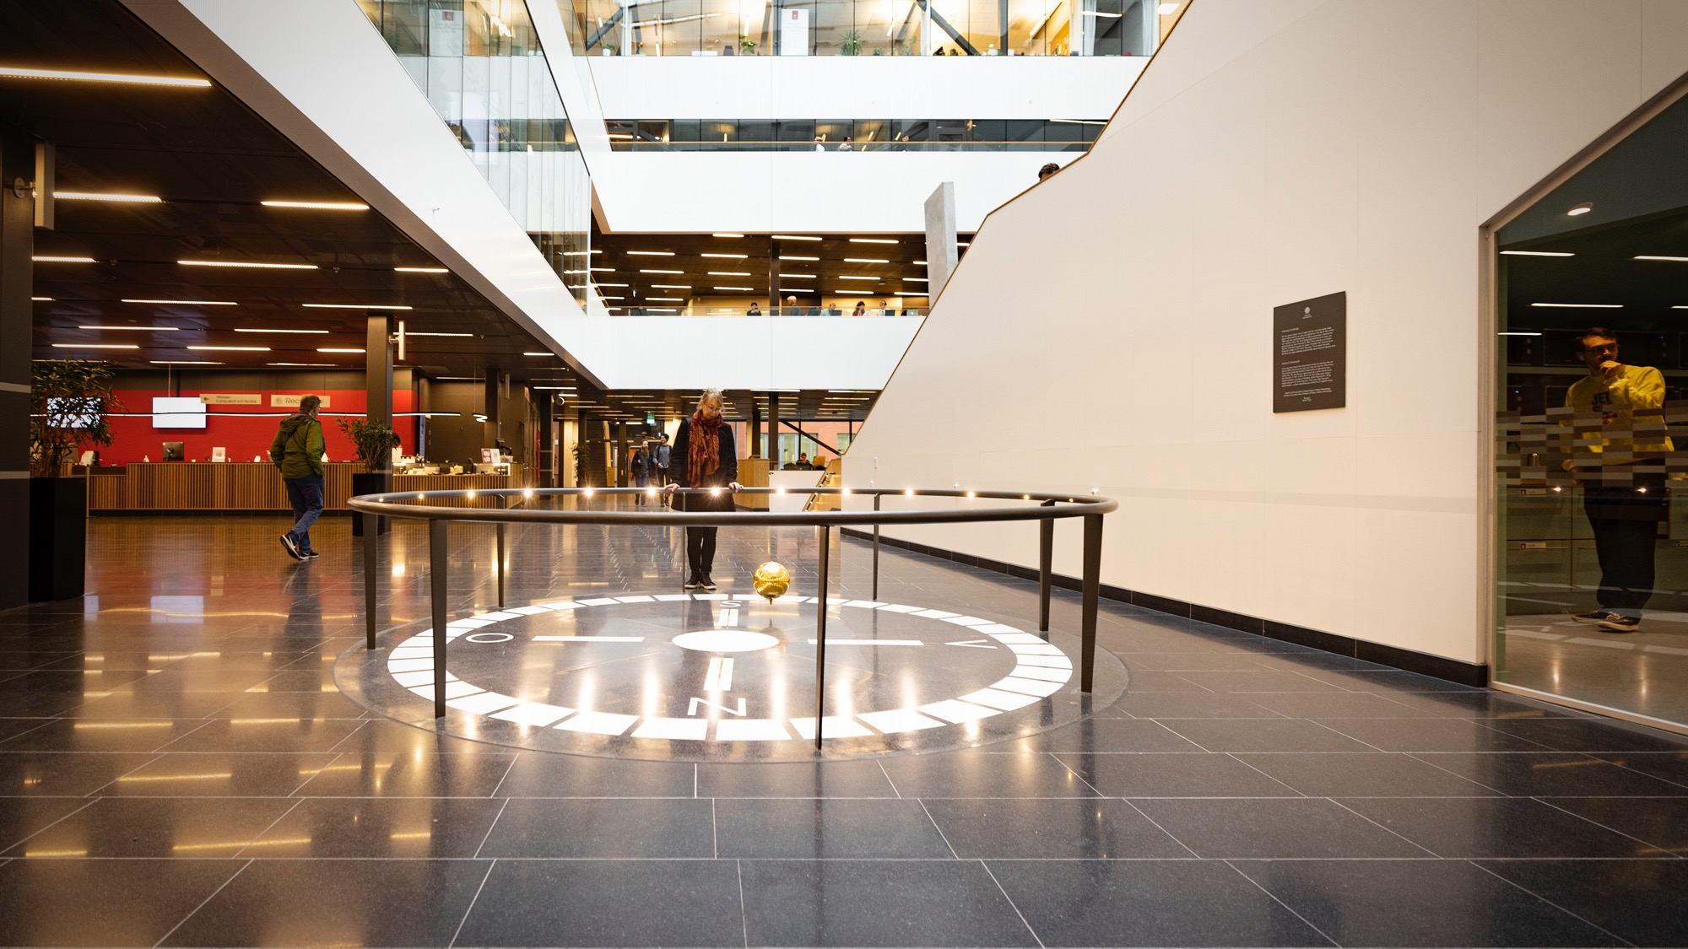
Notes:
Foucault pendulum at the Ångström Laboratory.

Slide 30
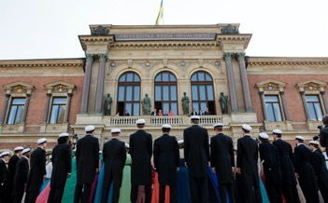
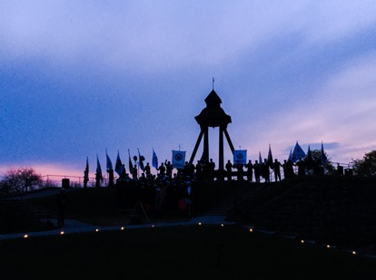
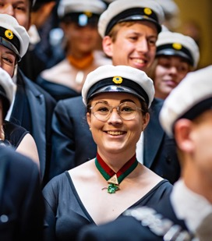
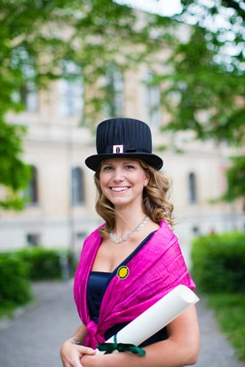
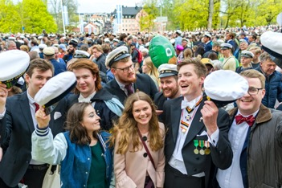
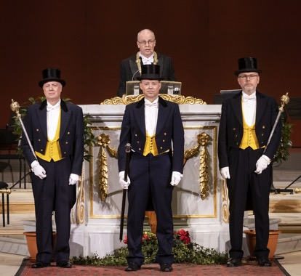
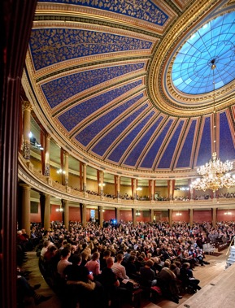
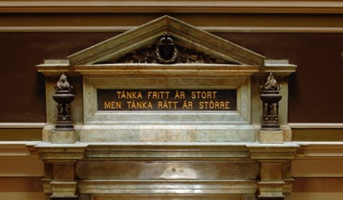
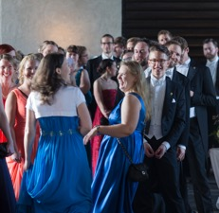
LIVING TRADITIONS

Slide 31
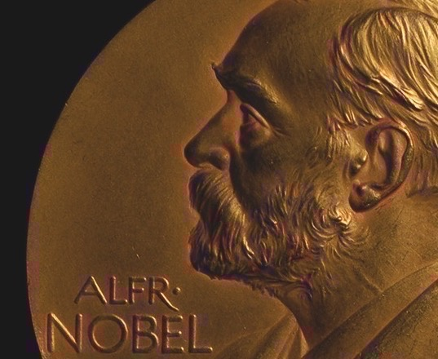
NOBEL LAUREATES
Allvar Gullstrand – Physiology or Medicine 1911
Robert Bárány – Physiology or Medicine 1914
Manne Siegbahn – Physics 1924
The Svedberg – Chemistry 1926
Nathan Söderblom – Peace 1930
Arne Tiselius – Chemistry 1948
Dag Hammarskjöld – Peace 1961
Kai Siegbahn – Physics 1981
Svante Pääbo – Physiology or Medicine 2022

Slide 32
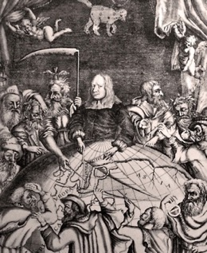
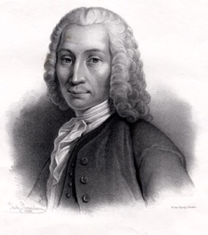
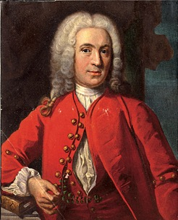


SOME FAMOUS FIGURES IN
UPPSALA’S HISTORY
Olof Rudbeck
1630-1702
Anders Celsius
1701-1744
Carl Linnaeus
1707-1778
Betty Pettersson
1838-1885
Ellen Fries
1855-1900
Notes:
Some famous figures in Uppsala’s history:
Olof Rudbeck:
The polymath Olof Rudbeck the Elder is one of the most significant personages of all time at Uppsala University. Rudbeck achieved something that has been called “the first scientific discovery ever made by a Swede”. His discovery concerned lymph and its flows through the human body. At the beginning of the 1660s he had the anatomical theatre set up for dissections of the human body. Rudbeck actually owed his celebrity mostly to his book “Atlantica”, a work of prehistory that is now generally regarded as learned fantasy. However, much of Rudbeck’s other work has stood the test of time. For example, he and Chancellor Magnus Gabriel De la Gardie established the exercitia (exercises) at the University, which meant that noble students received training in riding, dancing, fencing and modern languages. He also had a botanical garden planted (now the Linnaeus Garden), organised boat services to Stockholm, bridges, water pipes, etc.
Anders Celsius:
Celsius did not invent the thermometer. It had been known for more than a century, in Sweden as elsewhere. However, in 1741 he constructed a thermometer of superior precision. It was divided into 100 degrees, with 0 degrees denoting the boiling point of water and 100 degrees its freezing point. A few years after it had been taken into use, Celsius died (1744). His scale was then reversed and the thermometer took on its now familiar form, with the freezing point at 0 degrees and the boiling point at 100 degrees. Some have said that Linnaeus was behind this reform, but it was probably the idea of some instrument maker at the Royal Swedish Academy of Sciences.
However, Anders Celsius was first and foremost an astronomer, not a meteorologist. He was appointed Professor of Astronomy in 1730.
Carl Linnaeus:
Carl Linnaeus is one of Uppsala University’s most famous professors ever. Linnaeus created systems for classifying and naming nature, and the basics of his systems are still used today throughout the scientific world. “God created, Linnaeus organised” has become proverbial.
Betty Pettersson:
It was not until the early 1870s that the first female student enrolled at Uppsala University. At that time, a woman could only enter university by royal dispensation. Her name was Betty Pettersson and she came from the Baltic island of Gotland. After taking her degree she became a teacher.
Ellen Fries:
In 1883 Ellen Fries took a doctorate in history. She was the first woman in Sweden to obtain a PhD. While many hailed her as a pioneer, others were sceptical. Ellen Fries continued to write works of history, including the book “Remarkable Women”.
Toward the end of the century there were more and more women students, making a total of 153 admissions for the 19th century. But their life in Uppsala was not always plain sailing. They were not allowed to attend parties at the student nations (student clubs), and it was long questioned whether they had any right to wear the white ‘student cap’.
More famous figures in Uppsala’s history: http://www.uu.se/om-uu/history/

Slide 33

ORGANISATION

Slide 34

Notes:
Disciplinary Domain of Humanities and Social Sciences

Slide 36

Notes:
Disciplinary Domain of Medicine and Pharmacy

Slide 38

Notes:
Disciplinary Domain of Science and Technology

Slide 43
Notes:
This is Uppsala University

